Slide 1
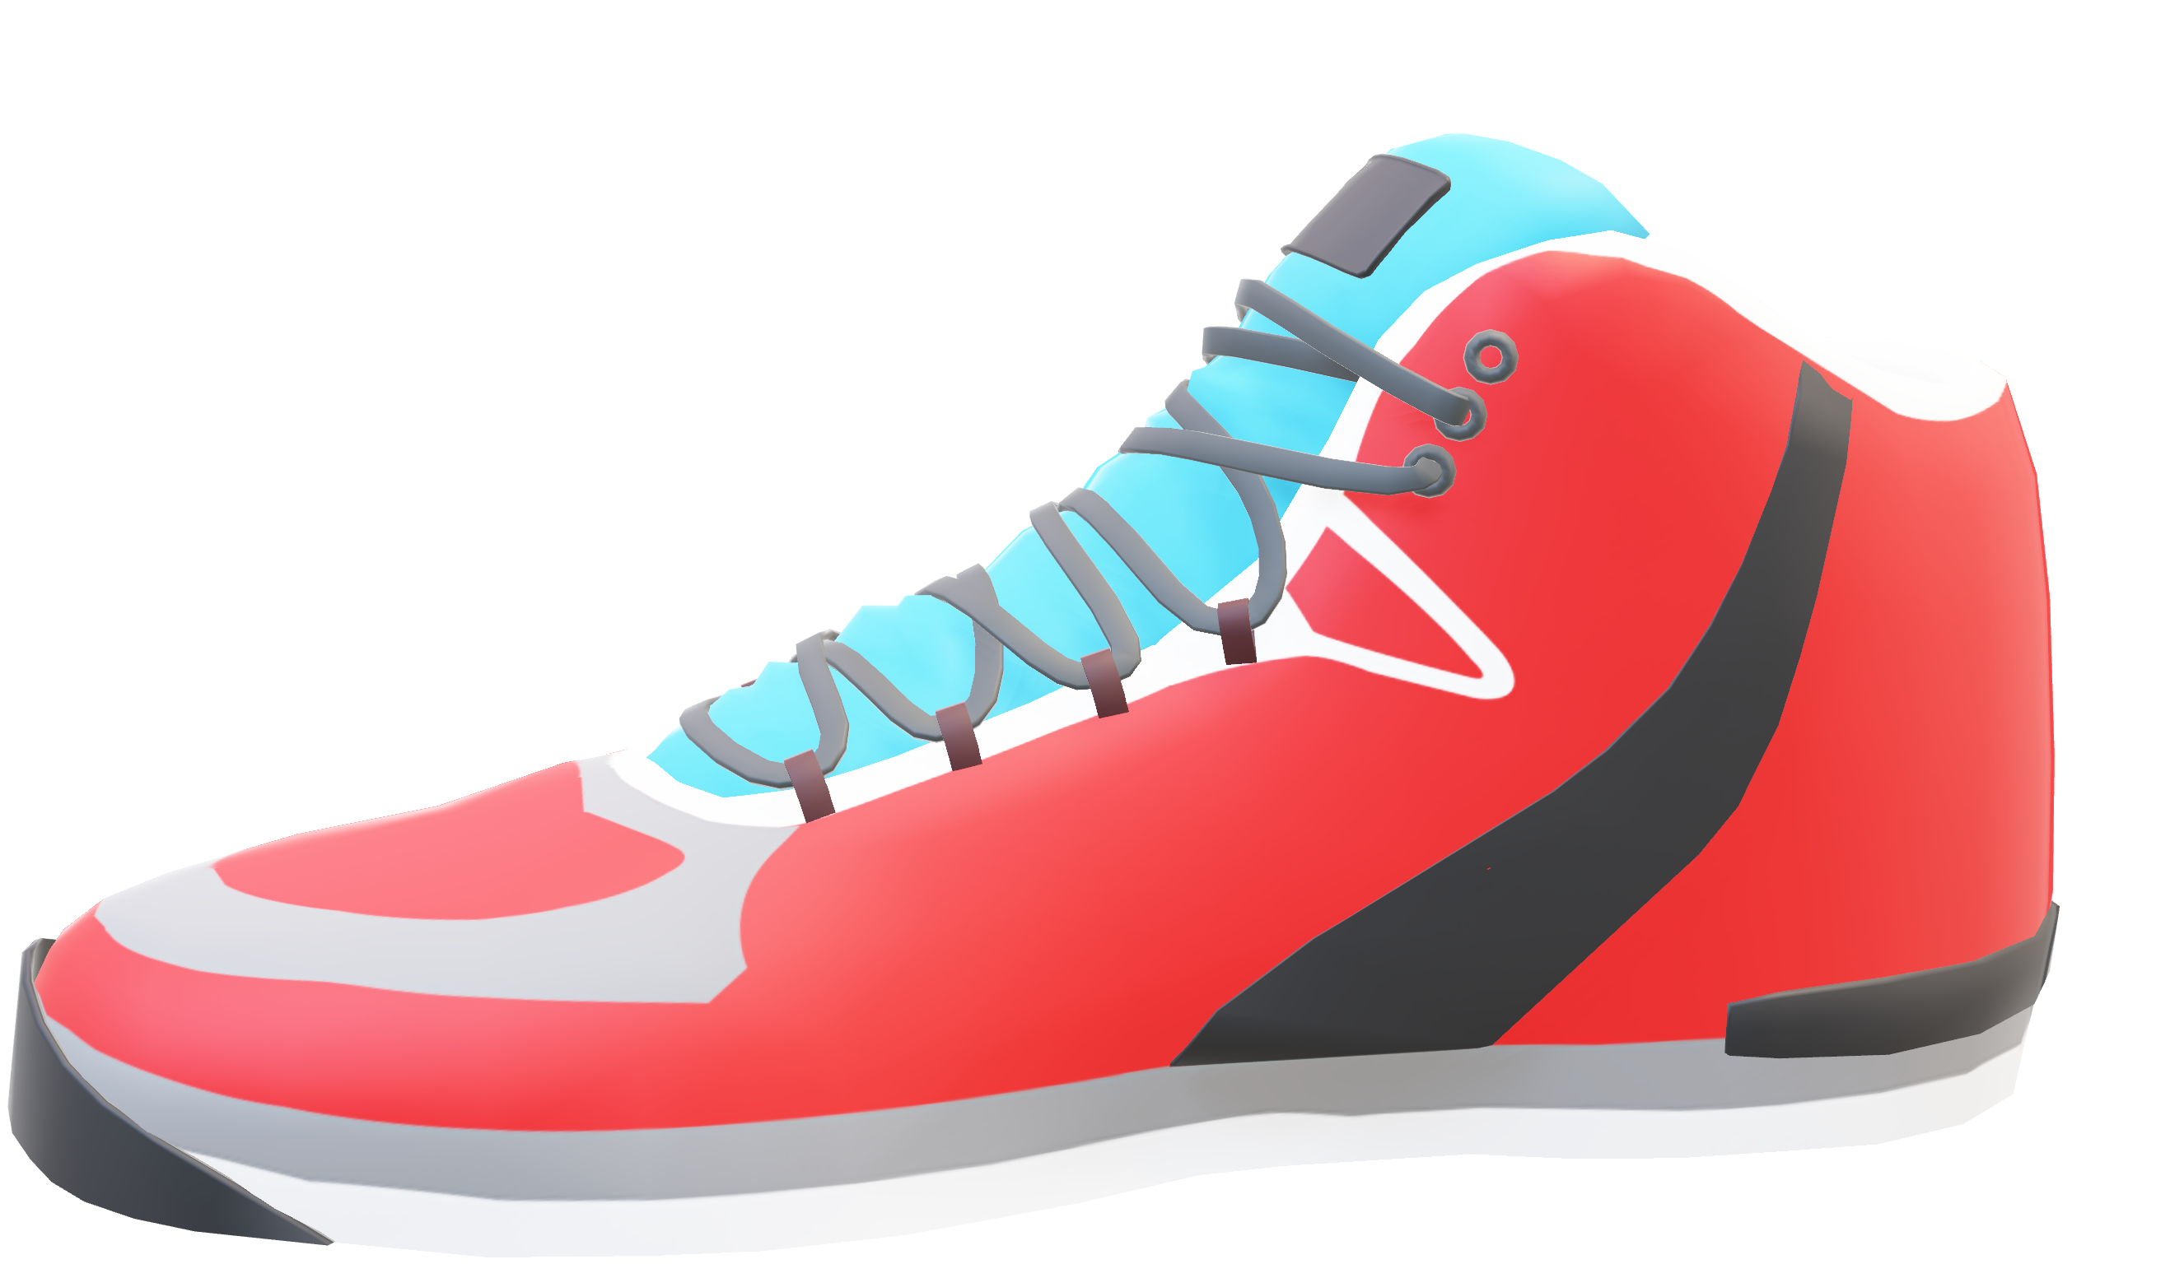
NIKE
CELINE MARIA LEO
MEGHANA YADAV
ALY 6000 – Introduction to Analytics

Slide 2
NIKE
JUST DO IT.

Slide 3

ABOUT US
Dataset Overview
Nike retail and online sales dataset from Kaggle for practicing data cleaning, preprocessing, and exploratory analysis.
Date range: Jul 2023 – Jul 2025
Key Features
Product Information: Product line, name, size, and price
Customer Attributes: Gender category
Sales Channels & Regions: Online/offline channels and regional data
Use Cases
Analyzing sales trends, product performance, and patterns across regions and customer groups.
Practical example for real-world data analytics and visualization.

Slide 4
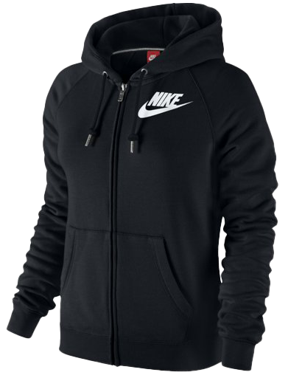
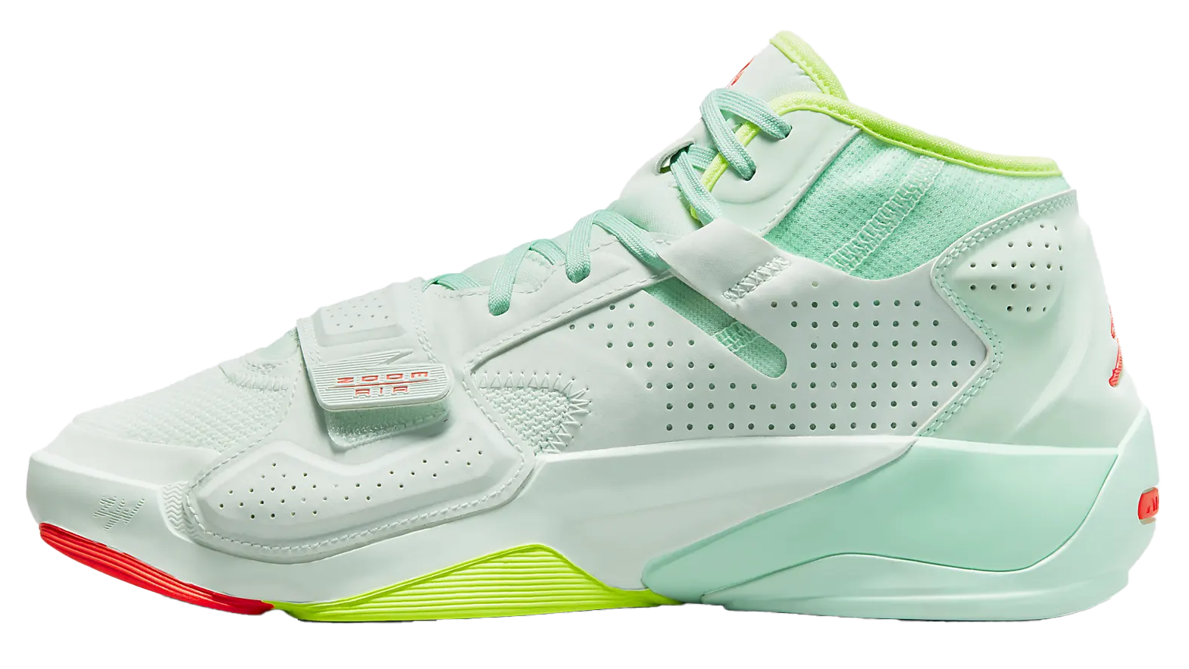

PRODUCTS
FOOTWEAR
APPAREL

Slide 5
DATA CLEANING
Removed irrelevant columns: Revenue, Profit, Discount Applied → simplified dataset for analysis
Fixed inconsistent data: Negative or missing (NA) data conversion for accurate calculations
Standardized dates: Converted Order Date to consistent format → timeline ready for trends
Dropped incomplete rows: → Removed NA rows
Standardized prices: Converted MRP from INR to USD (1 USD ≈ 88 INR) → consistent for analysis
Cleaned region names: Unified as “Bengaluru” and “Hyderabad” → accurate regional analysis
Calculated total sales: Sales = Units Sold × Price (USD) → added key metric for insights
Categorized products: Footwear (numeric sizes) / Apparel (S–XL) → easy comparison by product type

Slide 6

PROJECT PHASES
MARKET PERFORMANCE
TEMPORAL & PRICING
CHANNEL STRATEGY
STRATEGIC OPPORTUNITIES
PHASE 1
PHASE 2
PHASE 3
PHASE 4

Slide 7
PHASE 1
MARKET PERFORMANCE

Slide 8
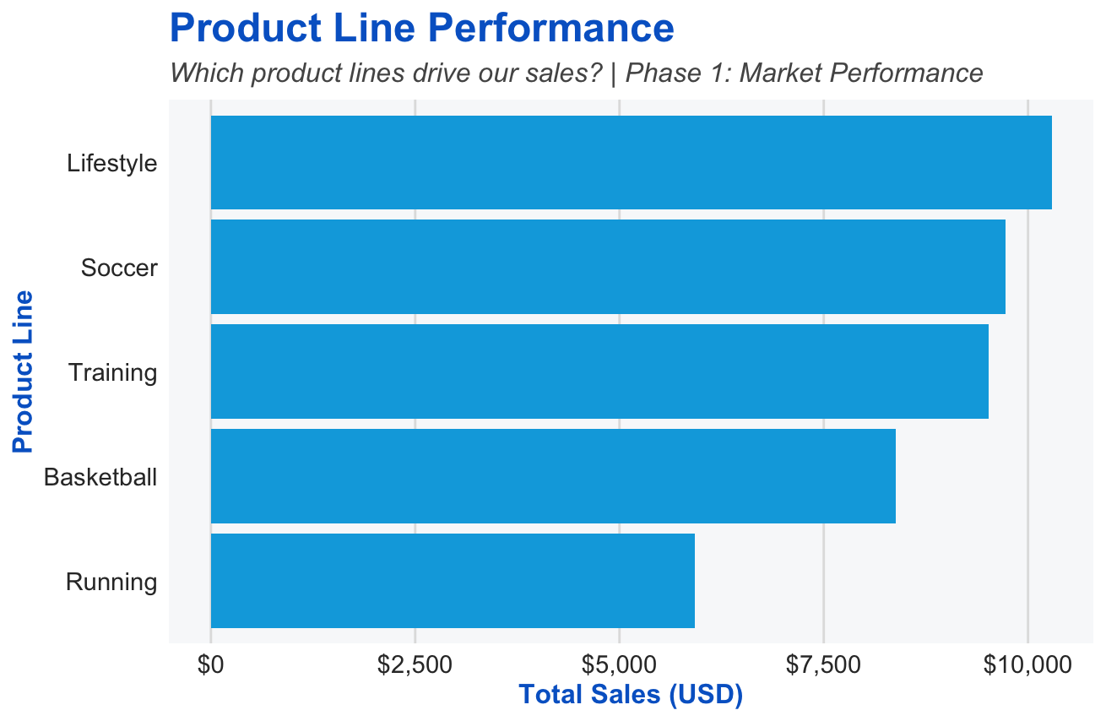

Slide 9
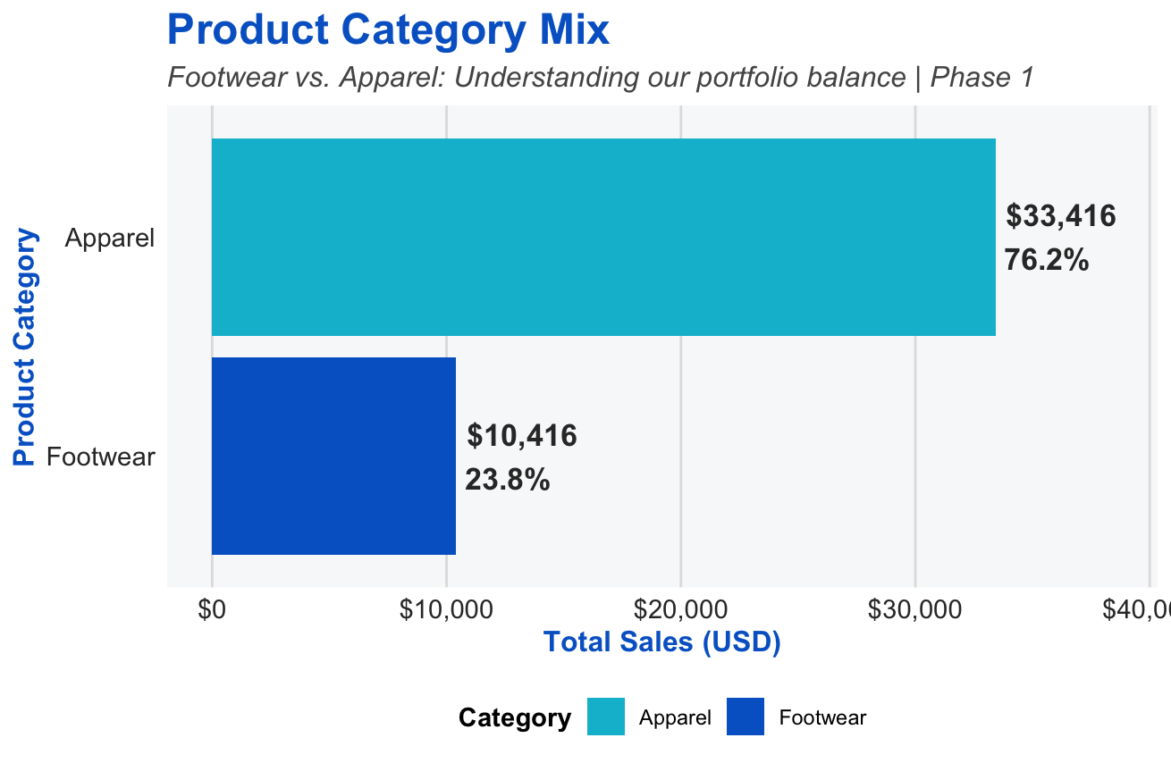

Slide 10
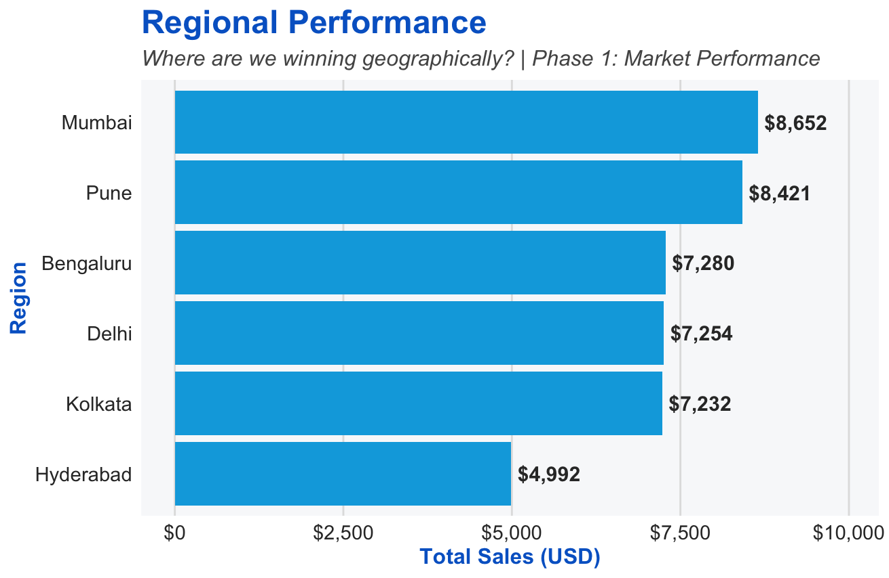

Slide 11
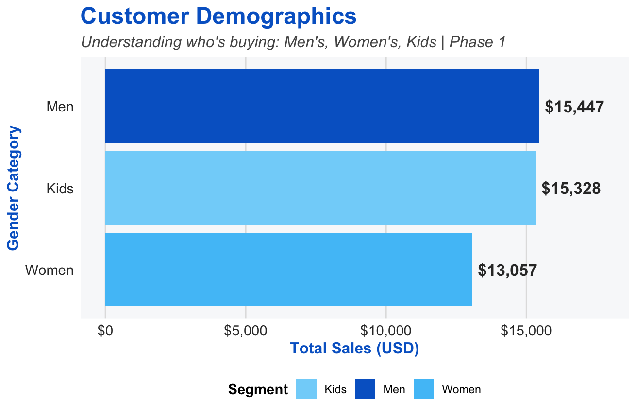

Slide 12
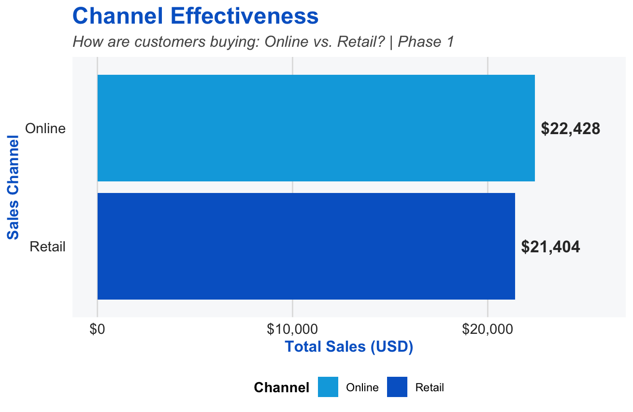

Slide 13
PHASE 2
TEMPORAL & PRICING

Slide 14
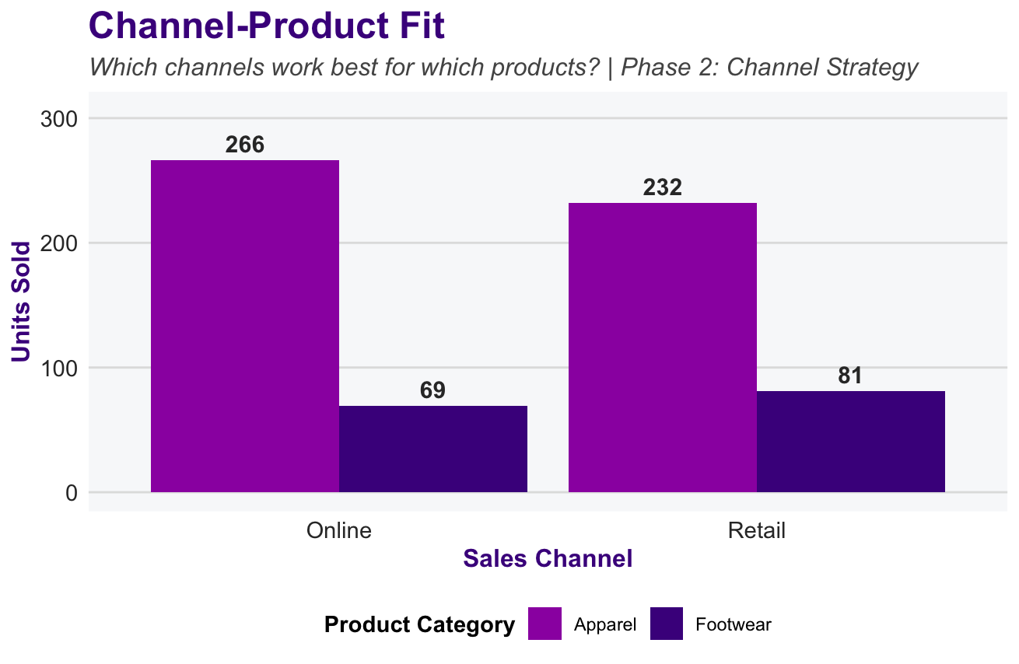
Notes:
This visualization helps identify which product types are best suited for each channel, which can be really useful for channel-specific marketing, stocking decisions, and sales forecasting.
Overall, this chart supports our Phase 2 Channel Strategy by showing that a one-size-fits-all approach doesn’t work — different product lines need different channel focuses.

Slide 15
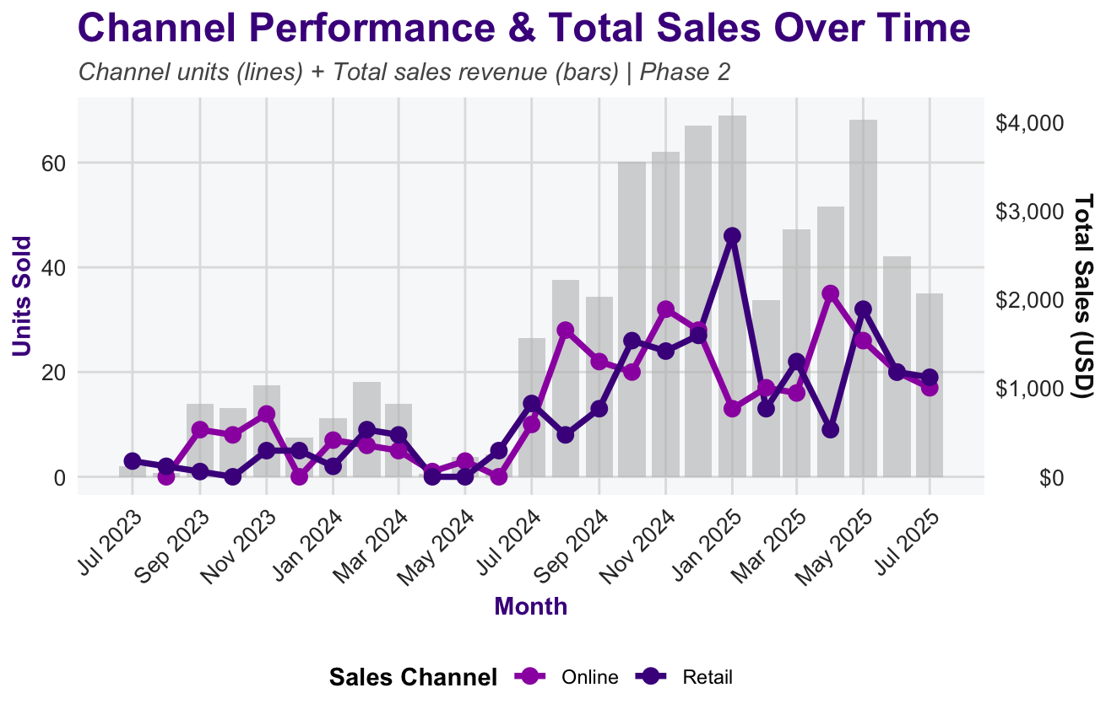
Notes:
Grey Bars (Background): Represent Total Sales (in USD) per month across all channels. → Gives a quick overview of overall sales performance over time.
Colored Lines & Points (Foreground): Represent Units Sold by Sales Channel:
Purple line: Online Channel
Dark Violet line: Retail Channel
→ Highlights how each channel contributes to total sales and how their performance fluctuates month-to-month.
Right Axis: Total Sales (USD) → Allows direct comparison between sales volume and revenue trends.

Slide 16
PHASE 3
CHANNEL STRATEGY

Slide 17
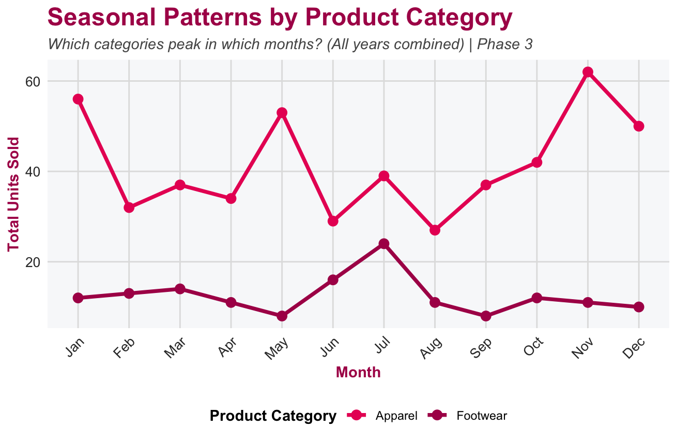

Slide 18
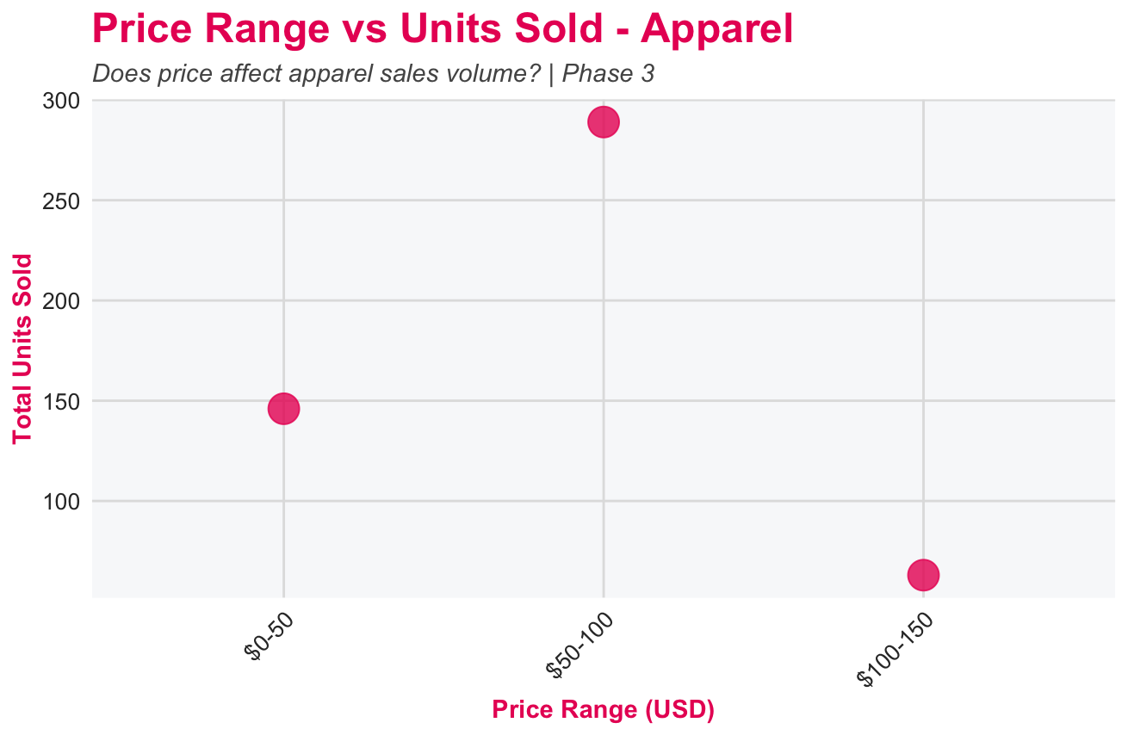

Slide 19
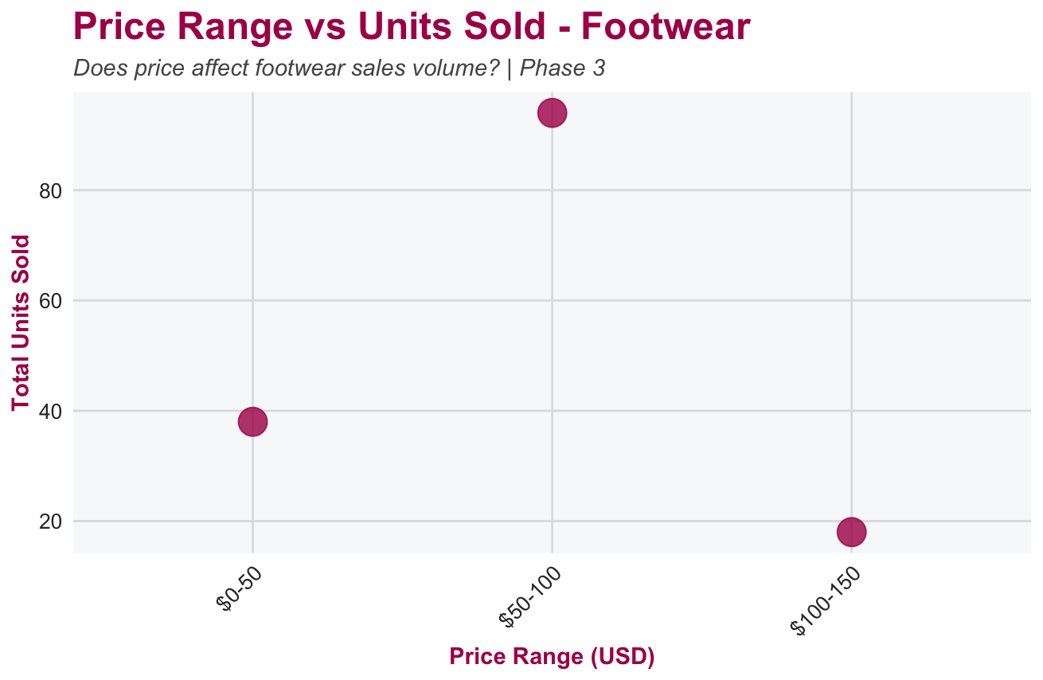

Slide 20
PHASE 4
STRATEGIC OPPORTUNITIES

Slide 21
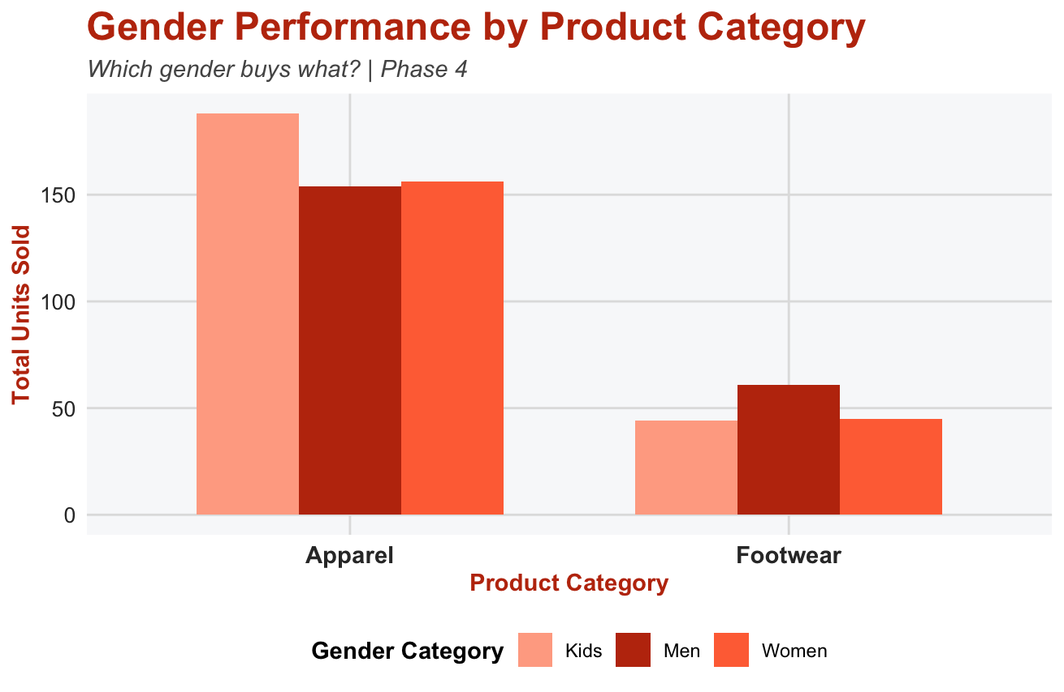

Slide 22
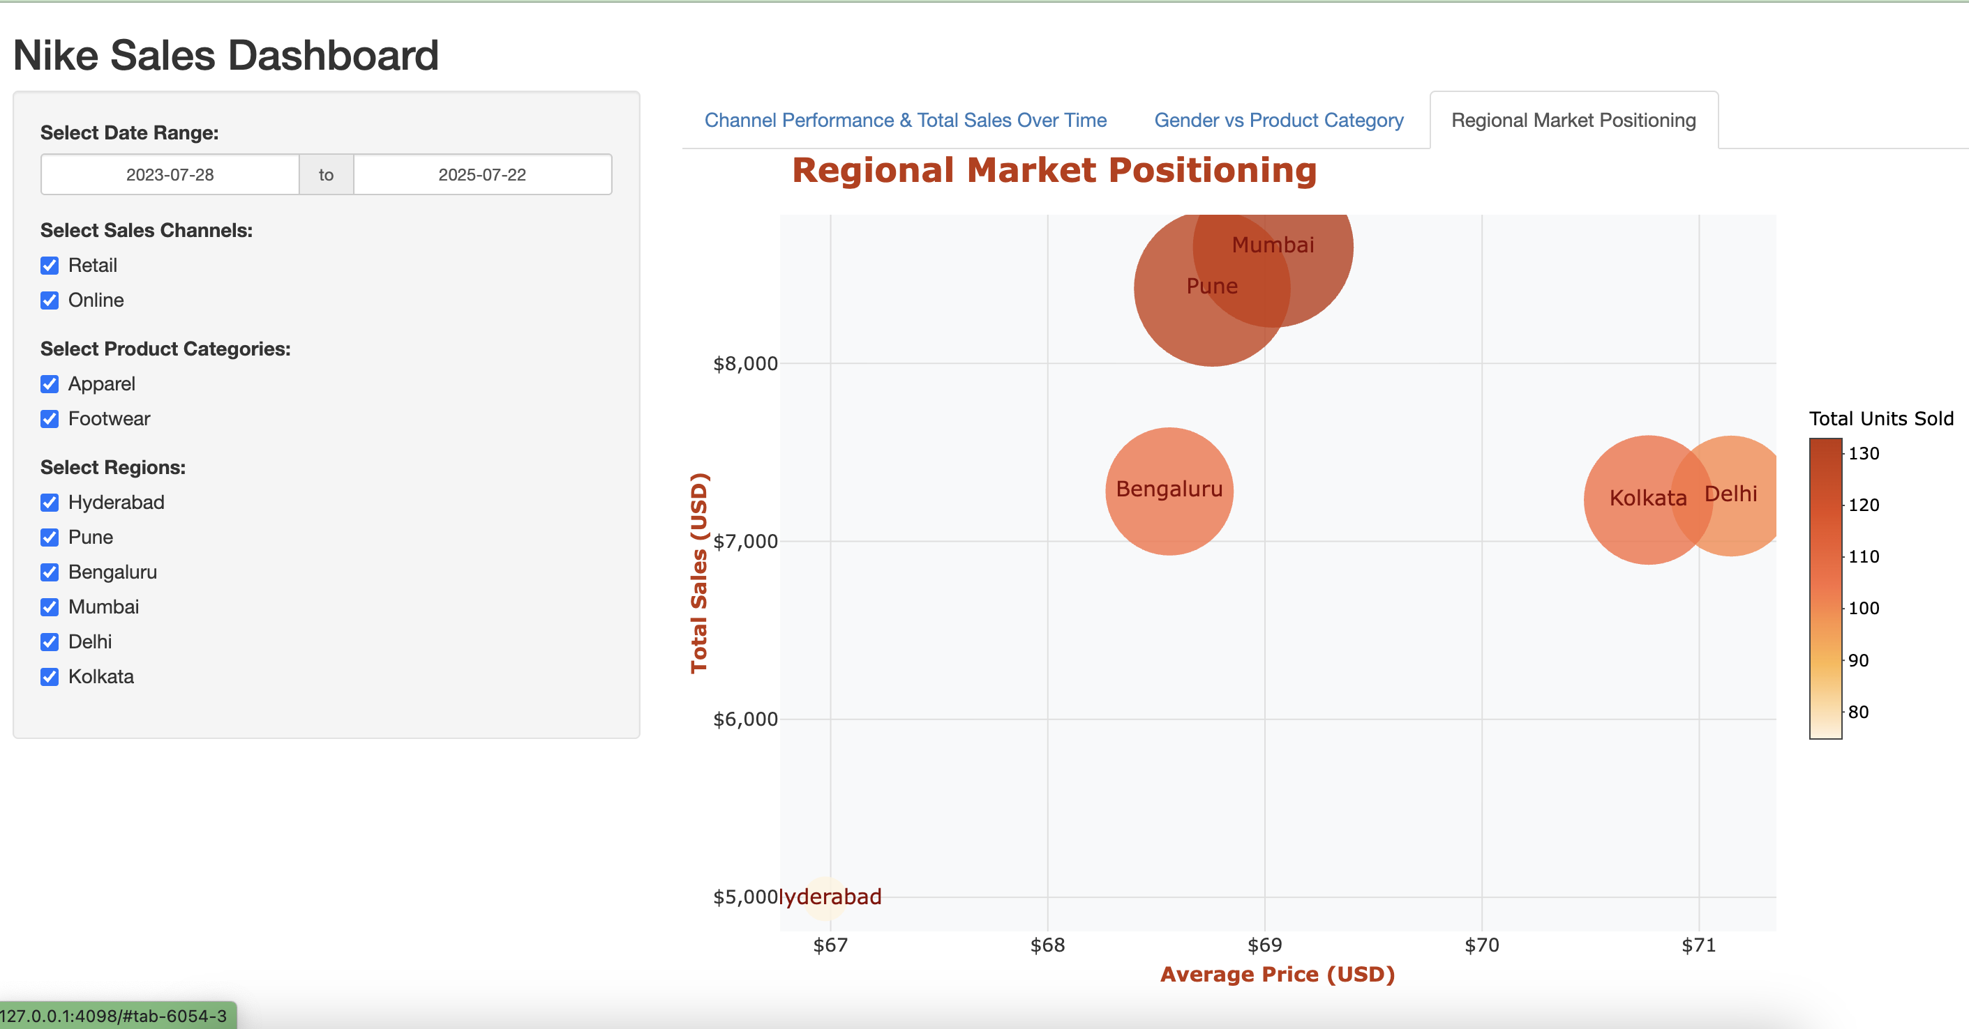
Notes:
The x-axis shows the average price of products sold in each region.
The y-axis shows the total sales revenue generated by that region.
The size and color of each bubble represent the total number of units sold
From this chart, we can identify which regions operate more like premium markets — with higher prices and high total sales — versus value-driven markets, where sales come mainly from larger quantities at lower prices.
By comparing the bubble sizes and positions, we can see which regions contribute most to revenue and which ones rely more on selling larger quantities rather than higher-priced items.

Slide 23
SUMMARY
Project Focus
Cleaned, transformed, and visualized an unprocessed Nike sales dataset to uncover meaningful business insights.
Tools & Methods
Used R for data preparation, standardization, and feature creation to ensure data accuracy and consistency.
Applied ggplot and RShiny to build multiple visualizations and interactive dashboards.
Key Insights
Identified trends in product performance, regional sales, customer behavior, and channel effectiveness.
Revealed patterns in market demand, pricing impact, and consumer preferences to support data-driven decisions in sales planning and marketing optimization.
Reference:
https://www.kaggle.com/datasets/nayakganesh007/nike-sales-uncleaned-dataset

Slide 24
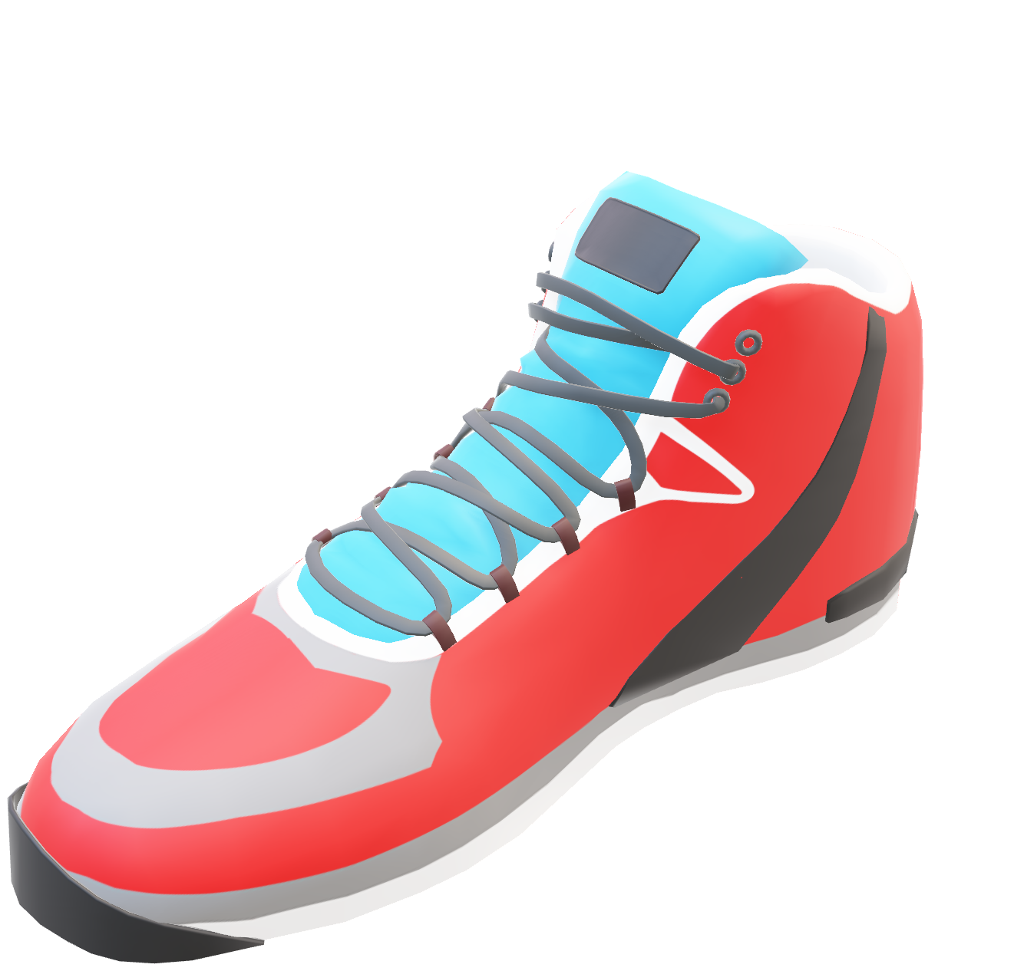
THANK
YOU

